Slide 1
Mobile Programming Workshop
Dr. Abbas Heydarnoori
March 2023

Slide 2
Outline
Challenges of mobile app development
Native vs. cross-platform vs. hybrid languages
Introduction to the Flutter cross-platform framework
Introduction to the Dart programming language
Setting up and creating basic apps and functionalities with Flutter
Learning materials for Dart and Flutter

Slide 3

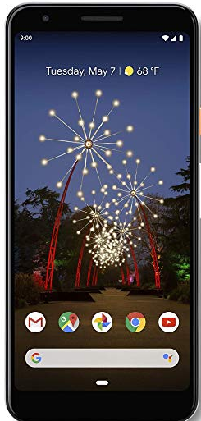
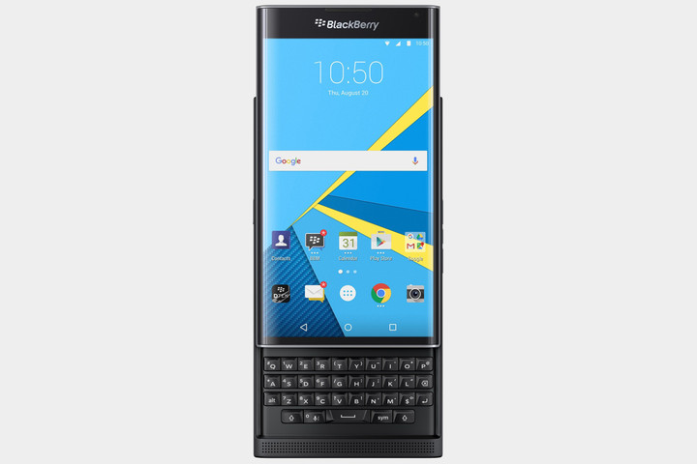
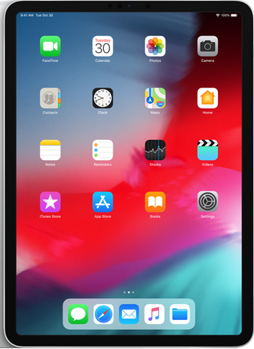
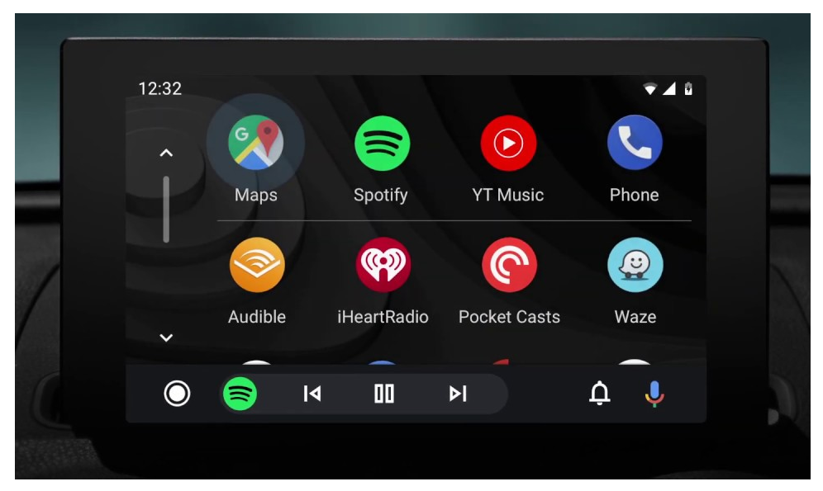
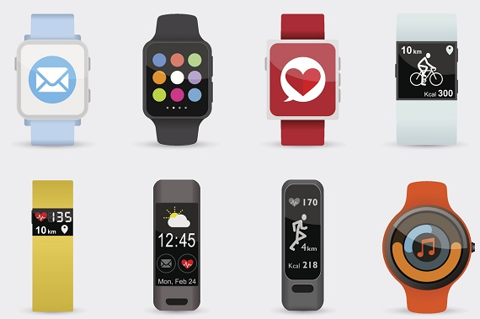
Mobile App Development Challenges
No “standard” device (iOS, Android, Windows Phone devices, Wearables, TV, Auto, etc.)
Low bandwidth input
Limited screen size
Unreliability in connectivity and device (network access, power, ambient light, noise, etc.)
Integration tradeoffs with cloud and enterprise services

Slide 4
Native vs. Cross-Platform vs. Hybrid
Native:
An application developed exclusively for a single platform using a native to the operating system language (e.g., an Android app or an iOS app)
Cross-Platform (or Multi-Platform):
Write code once and reuse for different platforms
Hybrid:
Consists of web and native solutions
Code written with web development languages (e.g., HTML, CSS) is embedded into a native app using plugins (e.g., Apache Cordova)

Slide 5

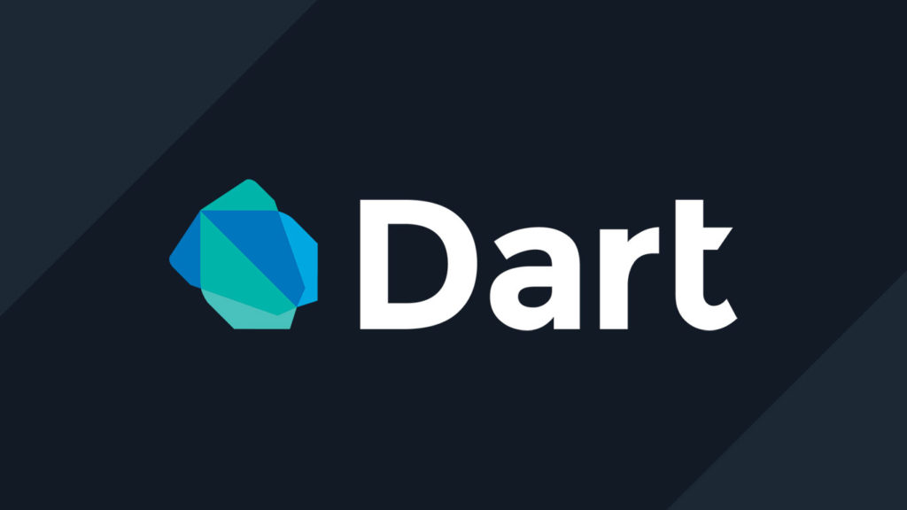
Flutter Cross-Platform Platform (https://flutter.dev/)
Flutter is an open-source framework by Google.
The underlying programming language is Dart, which was influenced by and has similarities to Java, C++, and C.
It provides the ability to build natively compiled applications for the web, Windows, macOS, Linux, iOS and Android using one single codebase.
Flutter is supported and used by Google and a large community of open-source developers around the world.

Slide 6
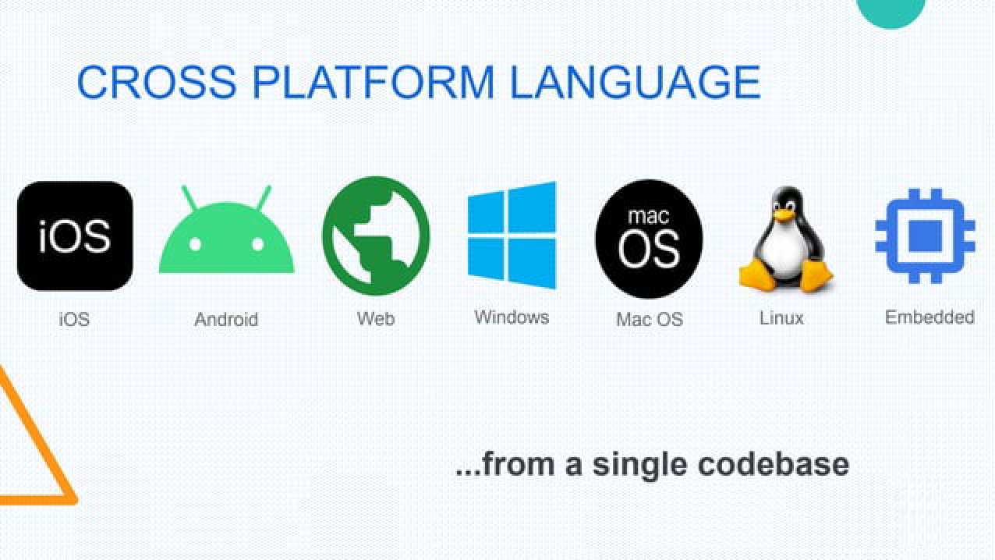
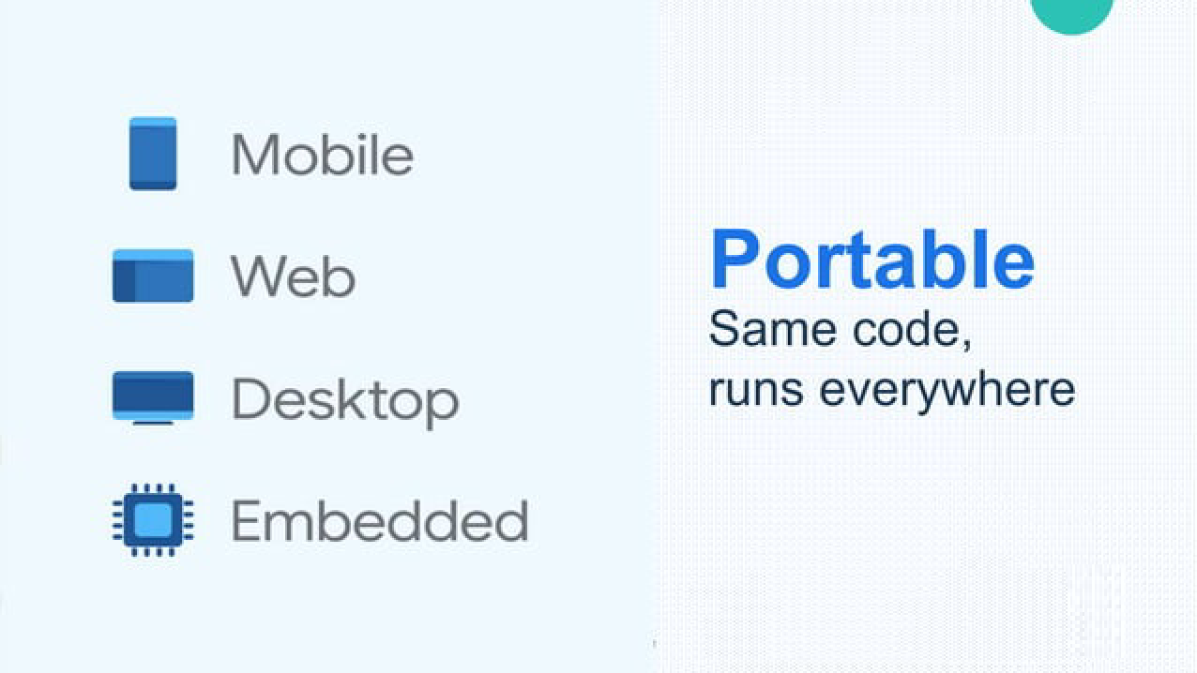
Why Flutter?

Slide 7
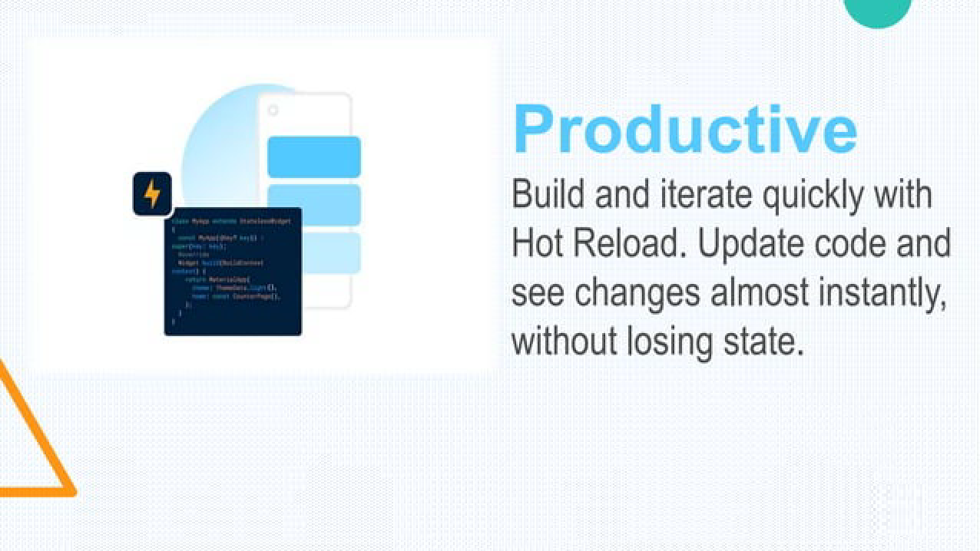
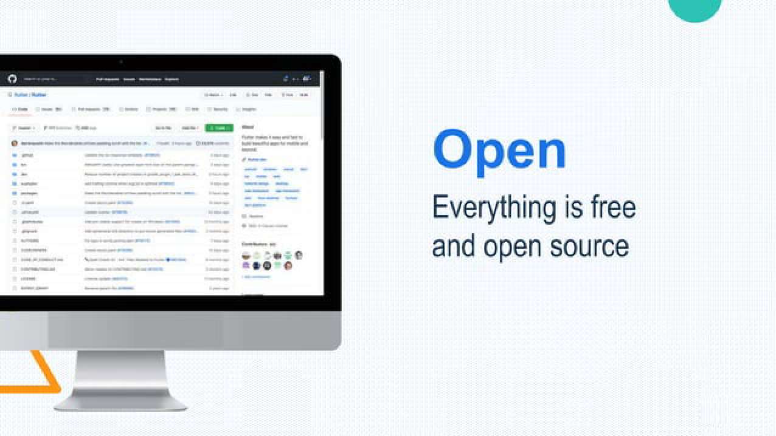
Why Flutter? (Cont’d)

Slide 8
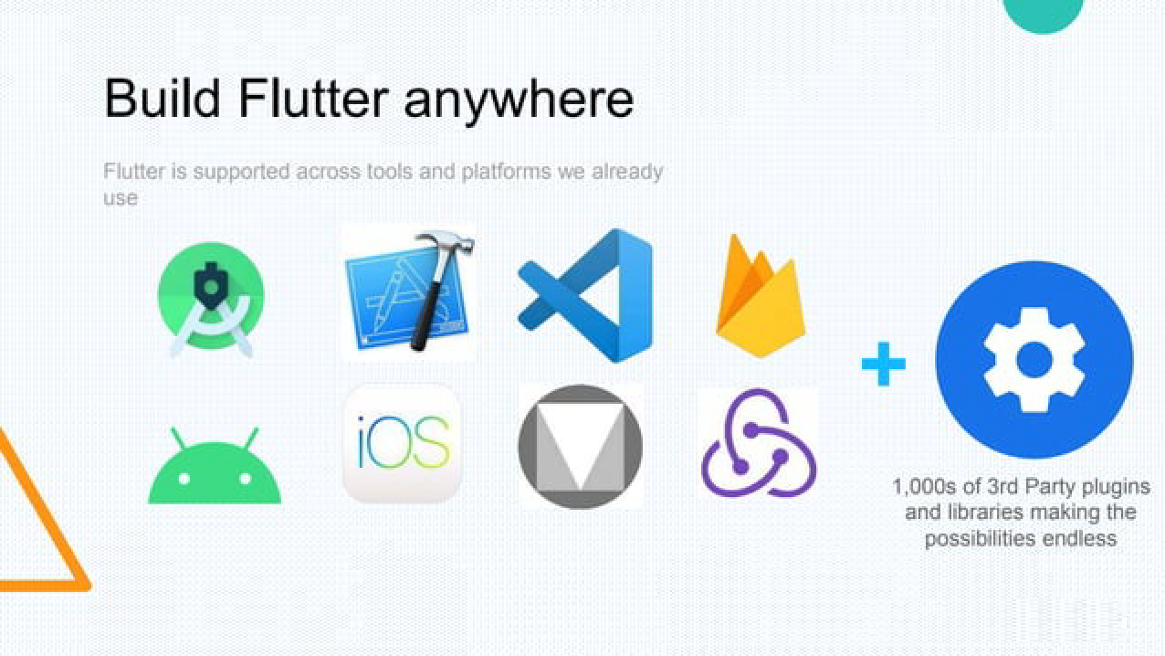
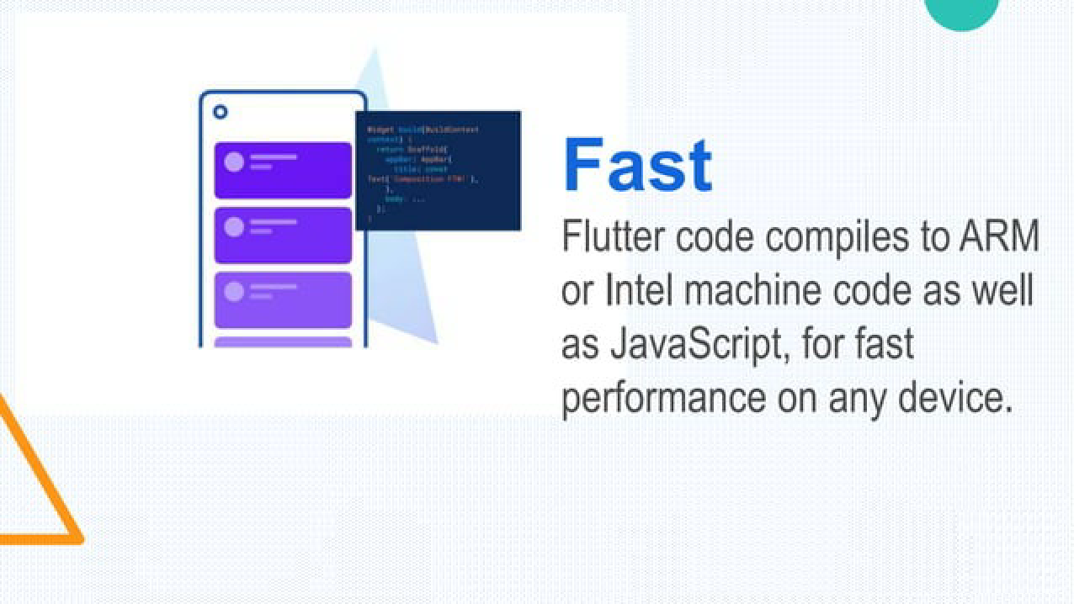
Why Flutter? (Cont’d)

Slide 9
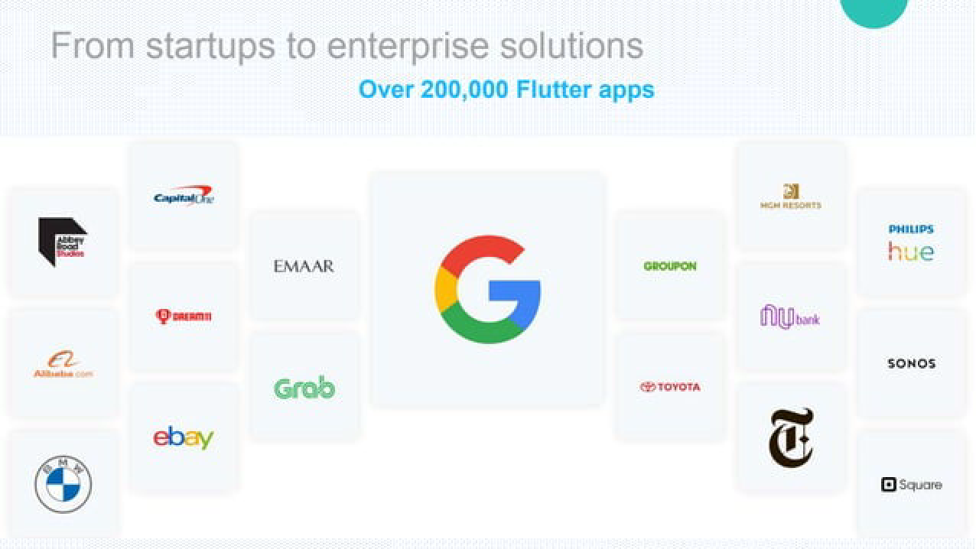
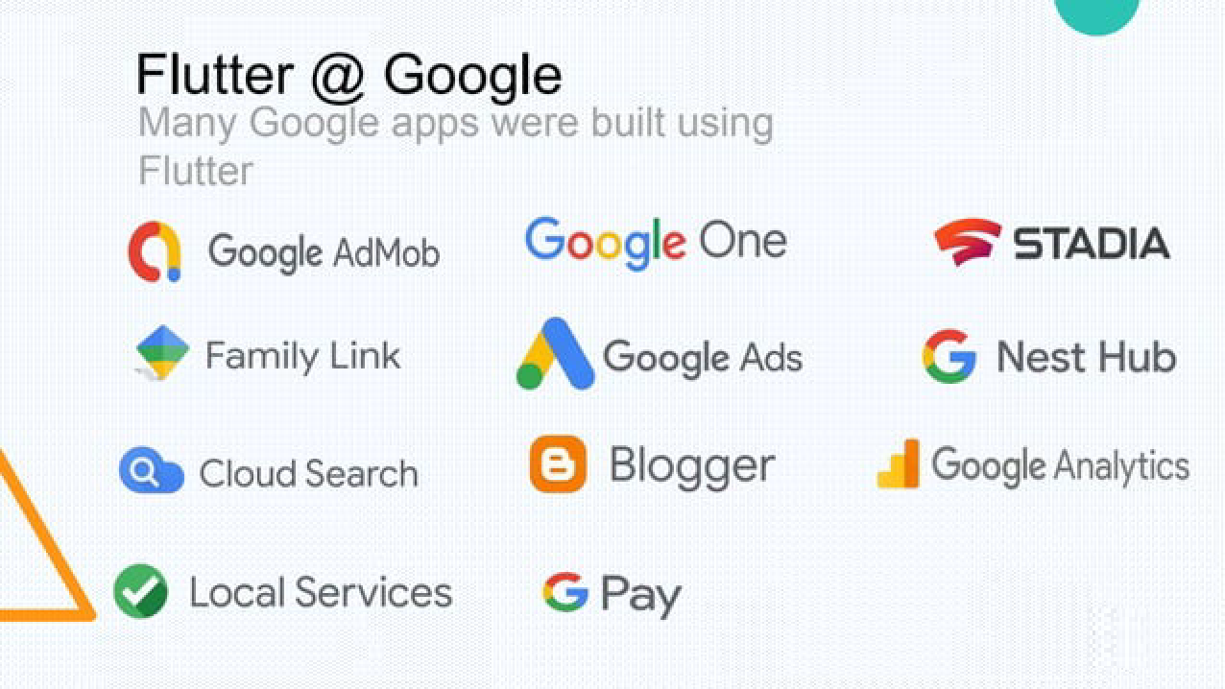
Why Flutter? (Cont’d)

Slide 10
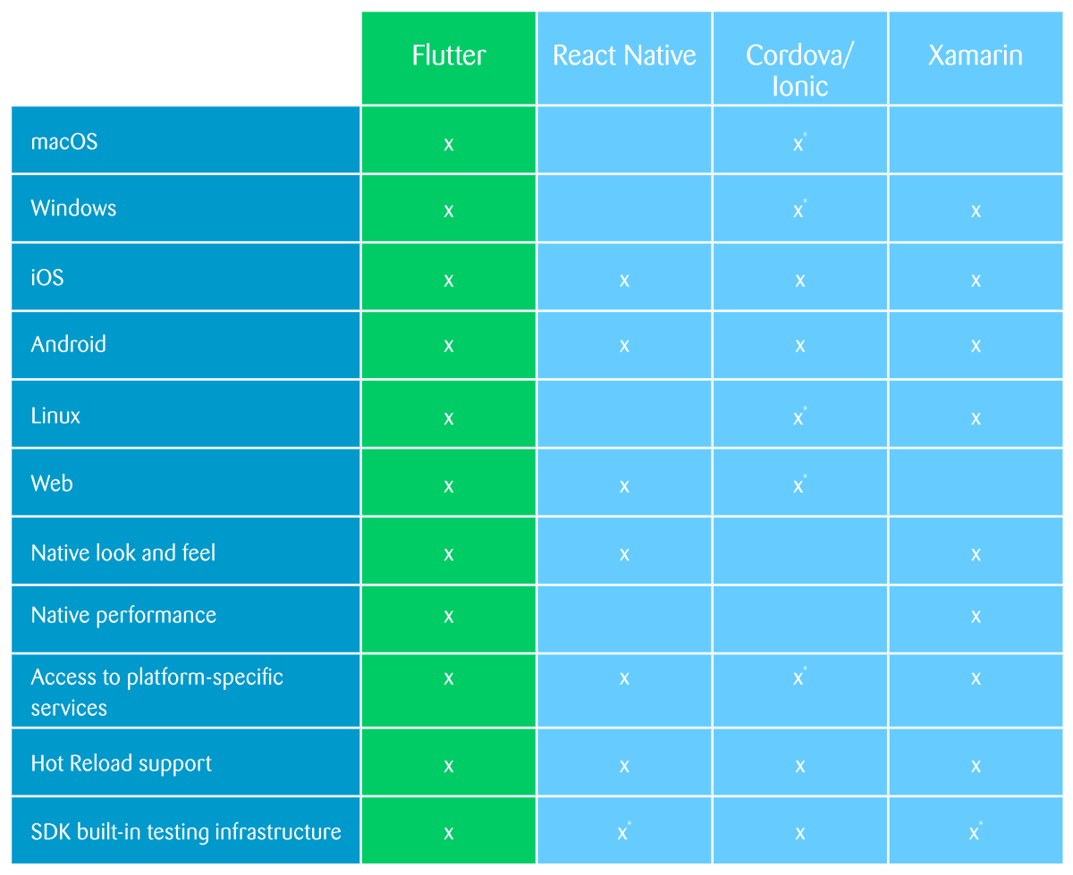
Flutter Compared to Other Cross-Platform Solutions

Slide 11
Cons of Flutter
Ever-growing range of tools and libraries. New iOS and Android features may not be supported.
Young technology. This can have an impact on the number of available experts and existing libraries.
Getting the platform-specific look and feel requires extra work.
Larger app size as Flutter has its own rendering engine.
We need to learn a new programming language: Dart.
Though it is not that difficult

Slide 12
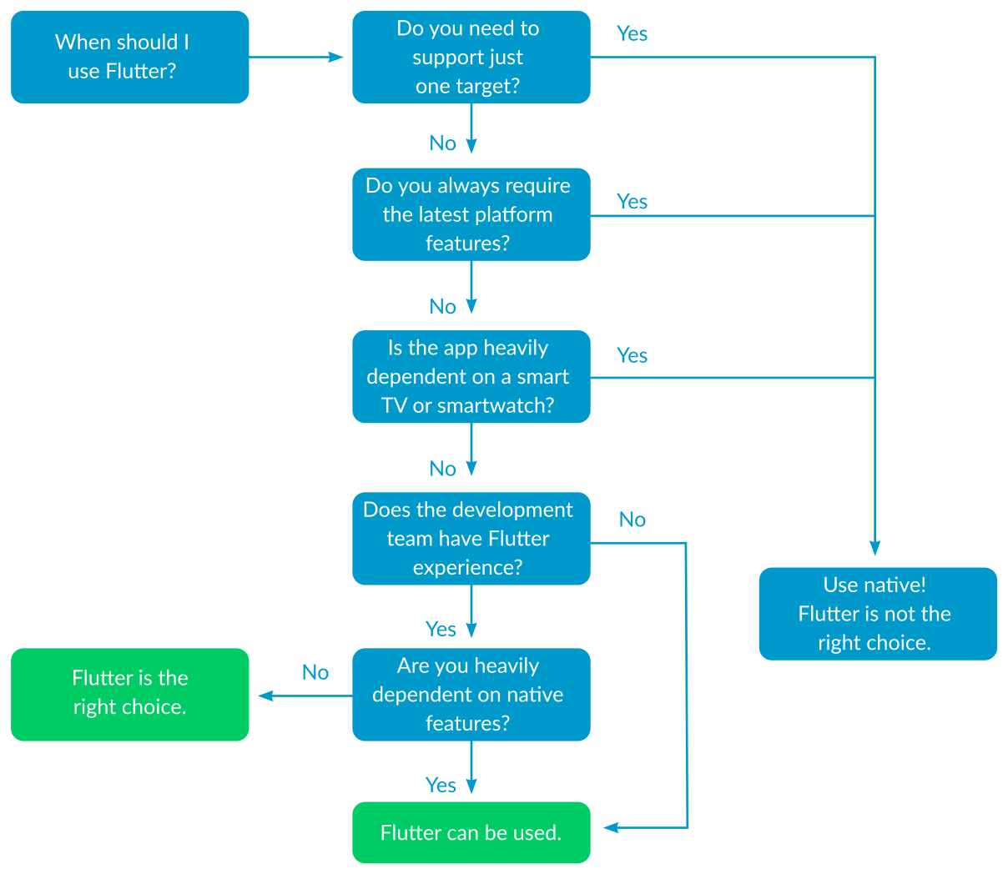
Decision Guidance

Slide 13
Dart Programming Language (https://dart.dev/)
Coding language used by the Flutter framework
Dart is a programming language designed for client development, such as for the Web and Mobile apps
It is developed by Google and can also be used to develop server and desktop applications
Dart is an object-oriented, class-based, garbage-collected language with C-style syntax

Slide 14
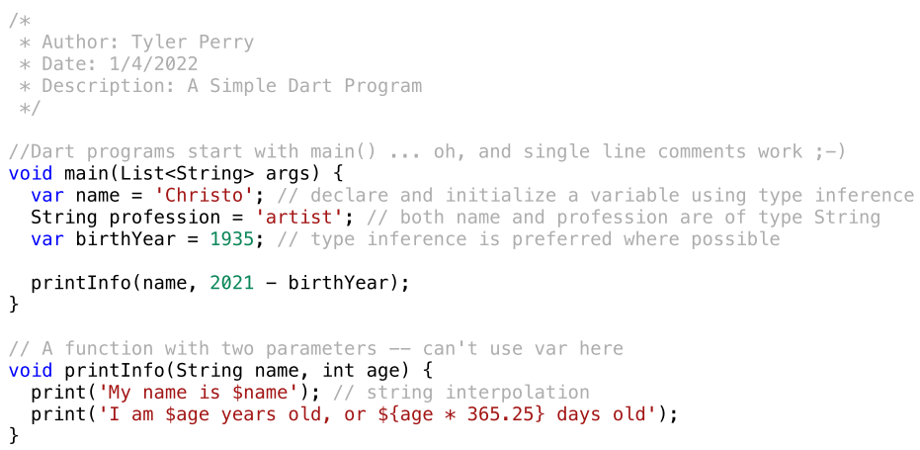
Hello Dart

Slide 15
Learning Dart
Dart Tutorials: https://dart.dev/tutorials
Dart Code Labs: https://dart.dev/codelabs
Dart Programming Course 2022: https://www.youtube.com/playlist?list=PLhQzRG2egYorICE_0jO_c7KrowIqJinin
Dart Tutorial 2021: https://www.youtube.com/watch?v=veMhOYRib9o

Slide 16
Installing Flutter
Step by step instructions for Flutter installation: https://docs.flutter.dev/get-started/install
For example, Windows installation: https://docs.flutter.dev/get-started/install/windows
You may get various errors during the installation
The answers to some of the most common issues can be found here: https://codelabs.developers.google.com/codelabs/flutter-codelab-first#1
Otherwise, search the error in YouTube or Google to see the solution.
Run “flutter doctor” in the command line to make sure everything is alright

Slide 17
Getting Started
Setup an editor
VS Code: https://docs.flutter.dev/get-started/editor?tab=vscode
Android Studio: https://docs.flutter.dev/get-started/editor?tab=androidstudio
Setup your desired devices and emulator
Use Android Studio to setup devices including your development cell phone
Run “flutter devices” in the command line to see the list of connected devices

Slide 18
Structure of a Flutter App
Widgets:
In Flutter, everything is a widget, including the app itself.
Widgets are user interface components that are composed to create the user interface of the application.
Gestures:
Flutter widgets support interaction through a special widget, GestureDetector
GestureDetector is an invisible widget that captures user interactions such as tapping, dragging, etc., of its child widget
StatelessWidget vs. StatefulWidget:
A widget is stateful if can change when a user interacts with it (e.g., a CheckBox)
A stateless widget never changes (e.g., an Icon or a Text)

Slide 19
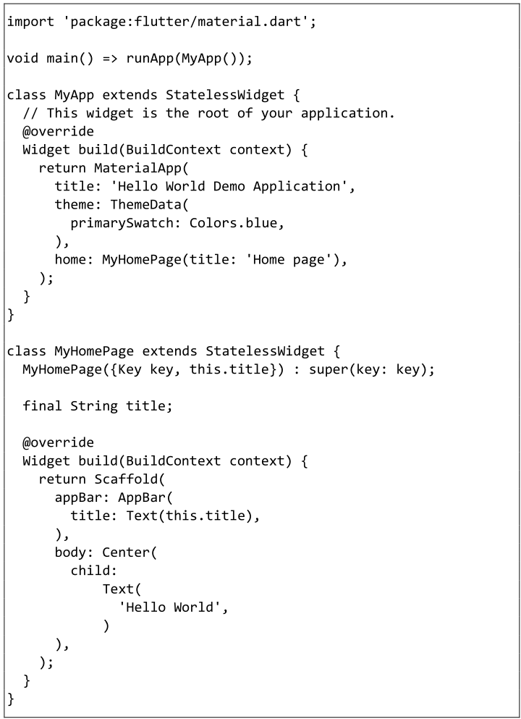
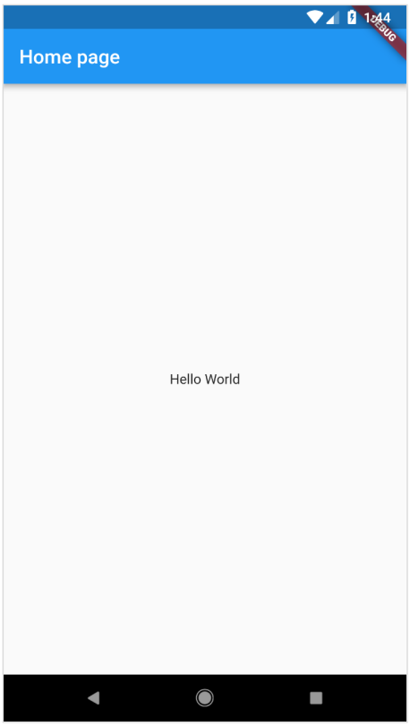
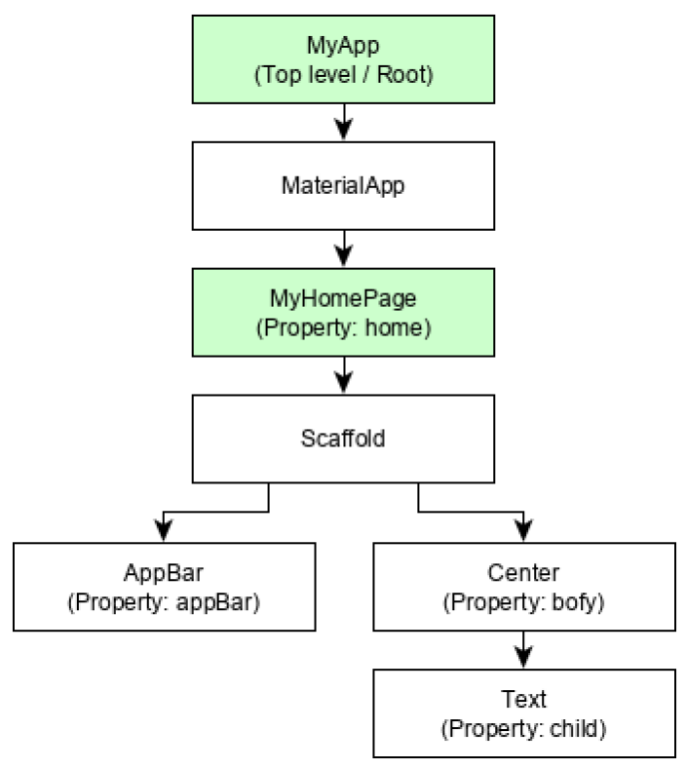

Slide 20
Demo (Test Drive)
Creating a Simple Application in Android Studio

Slide 21
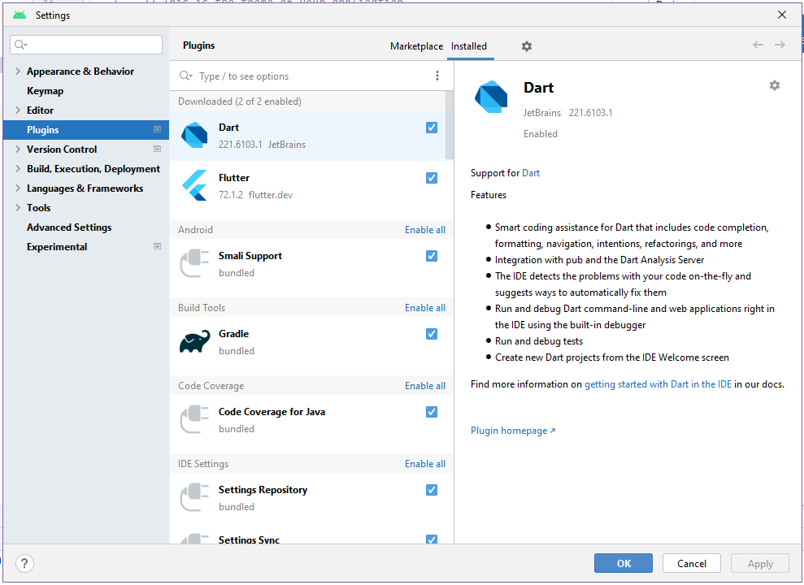
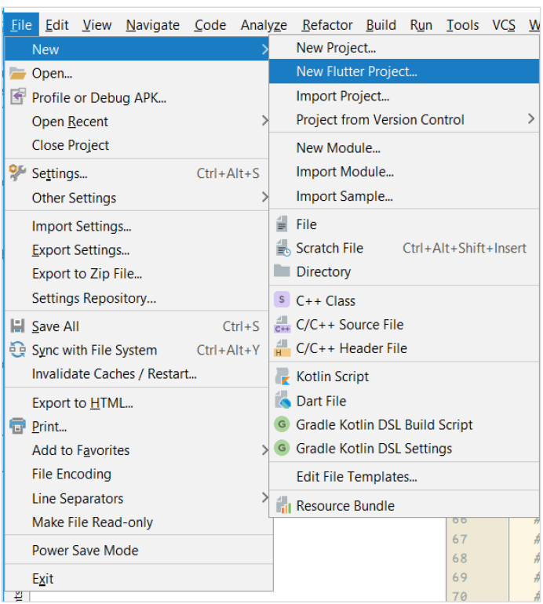

Slide 22
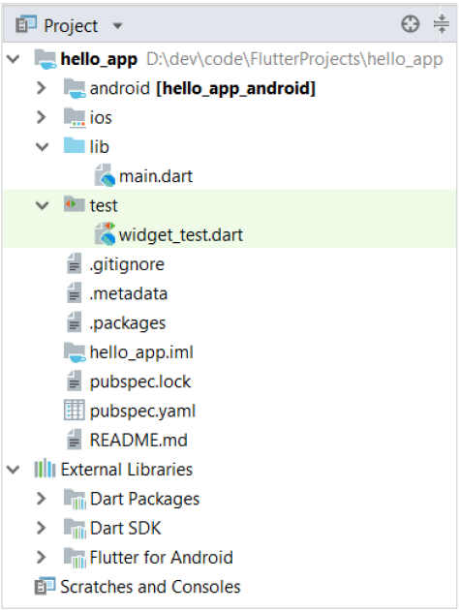
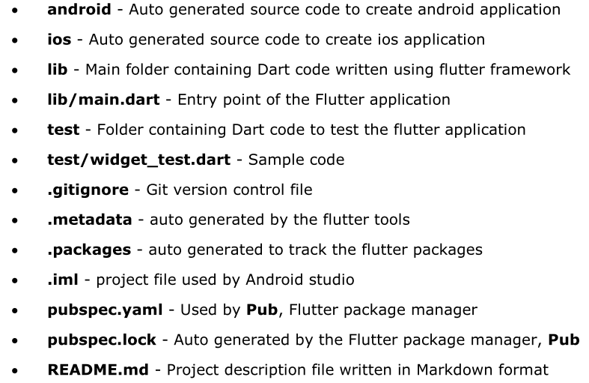

Slide 23
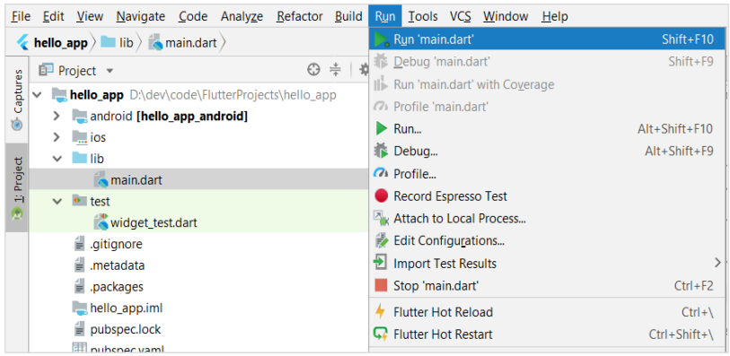

Slide 24
Demo: Codelab in VS Code
https://codelabs.developers.google.com/codelabs/flutter-codelab-first#0

Slide 25
Learning Flutter
Flutter Documentation: https://docs.flutter.dev/
Flutter Sample Codes (e.g., for routing, working with images, etc.): https://flutter.github.io/samples/
Official Flutter Channel in YouTube: https://www.youtube.com/@flutterdev
Flutter Tutorial for Beginners: https://www.youtube.com/playlist?list=PL4cUxeGkcC9jLYyp2Aoh6hcWuxFDX6PBJ

Slide 26
Learning Flutter: Working with Images
Add Images To Your App (+ source code): https://www.youtube.com/watch?v=mON4IupMyfo
Photo App Project (images and Firebase database) (+ source code): https://www.youtube.com/playlist?list=PLrTDw7ICfHFmjFny9XCCm1QwmK4mlLm3t

Slide 27
Learning Flutter: Google Maps and Tracking
Official Codelab: https://codelabs.developers.google.com/codelabs/google-maps-in-flutter#0
Official sample code: https://flutter.github.io/samples/place_tracker.html
Flutter Google Maps API Tutorial (+ source code): https://www.youtube.com/watch?v=Zz5hMvgiWmY
Flutter Live Location Tracker (+ source code): https://www.youtube.com/watch?v=Uz49GlqJ7m4

Slide 28
Summary: Flutter Strengths
Awesome documentation: entertaining, well-documented, and easy to search
Google is putting serious resources behind this
The Dart language is magniﬁcent and easy to learn
Developing in VSC or Android Studio using the Flutter extension is a sublime experience
Apps are truly fast
All the other advantages listed previously

Slide 29
Summary: Flutter Weaknesses
Flutter leverages the Android and iOS SDKs, and issues with the latter may be difﬁcult to diagnose
The initial installation is burdensome
iOS developers must be on Macs
The layout system can be difﬁcult, and you can't drag-and-drop the UI (applies to all declarative UI systems)
https://flutterviz.com/
https://flutterflow.io/

